Slide 1
Understanding the critical role of the epithelium as an immune-functioning organ and driver of multiple inflammatory pathways that underpin disease
Dr Simon Couillard
Université de Sherbrooke, Sherbrooke, Canada

Slide 2
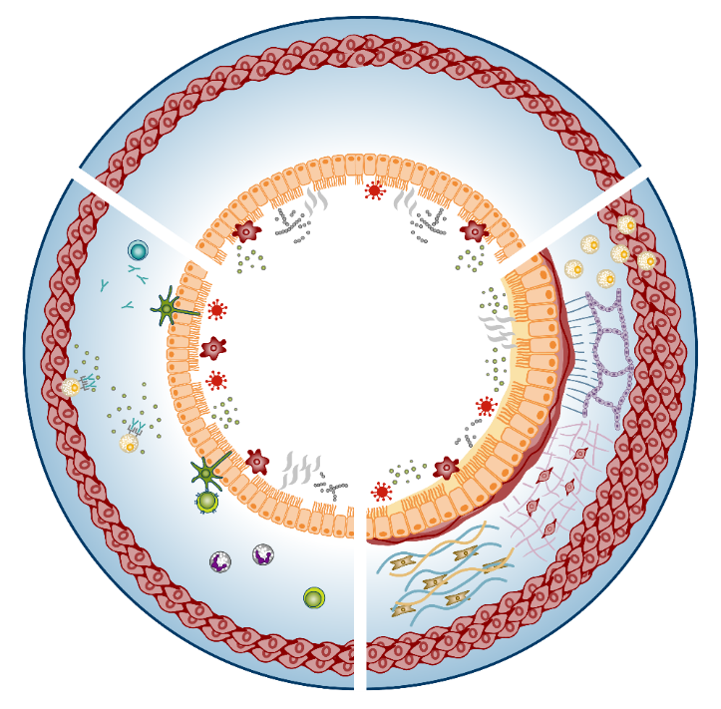

Epithelial damage is caused by allergens, pathogens and environmental insults^{1–6}
In patients with airway diseases, these triggers cause epithelial damage, which drives different inflammatory pathways^{1–7}
Inflammation is characteristic of airway diseases and can cause changes to the airway physiology via:
  Bronchoconstriction
  Reduced airway calibre
  Destruction of muscular and elastic components of the bronchial wall⁸
A common feature of airway diseases is the release of proinflammatory cytokines by the epithelium in response to injury^{1–7}
Healthy
airway
Allergens, viruses,
bacteria, pollutants,
cigarette smoke^{1–6}
References: 1. Gauvreau GM, et al. Expert Opin Ther Targets. 2020;24(8):777–92; 2. Calderon AA, et al. Eur Respir Rev. 2023;32(167):220144; 3. Brightling C, Greening N. Eur Respir J. 2019;54(2):1900651; 4. Fokkens WJ, et al. Rhinol. 2020;58(Suppl.S29):1–464; 5. Victor AR, et al. J Immunol. 2017;199(7):2333–42; 6. Staudacher AG, et al. Ann Allergy Asthma Immunol. 2020;124(4):318–25; 7. Raby KL, et al. Front Immunol. 2023;14:1201658; 8. Athanazio R. Clinics (Sao Paulo). 2012;67(11):1335–43.

Slide 3



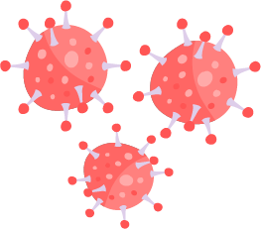




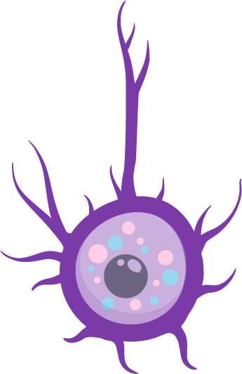

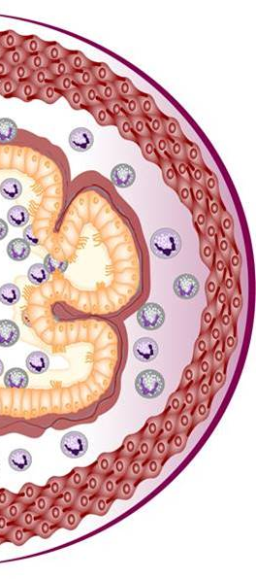
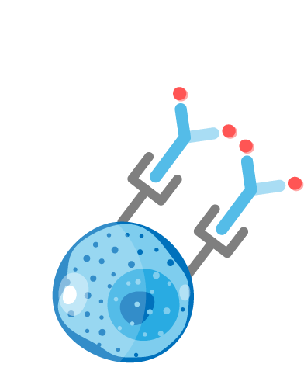
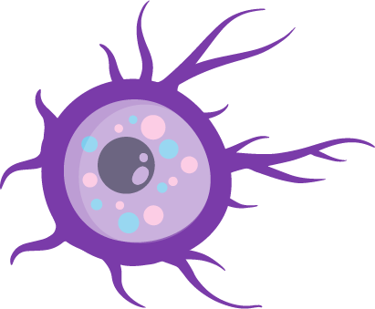
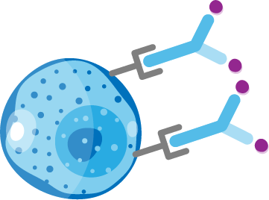




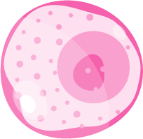

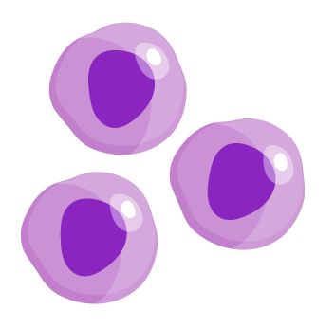



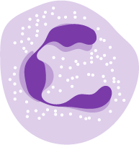

Various cells and inflammatory mediators are involved in downstream inflammatory pathways that drive asthma pathogenesis^{1,2}
Triggers
Allergens
Cytokines
Fungi
Bacteria
Viruses
Smoke
Pollution
Epithelium
Mucus
Airway
TSLP
IL-33
Goblet cell
TSLP
IL-33
IL-25
TSLP
IL-33
IL-25
TSLP
IL-5
IL-13
Mast cells
Collagen
Basophil
Dendritic cell
Naïve
T cell
IL-13
IL-13
TSLP
ILC2s
Histamine
Leukotrienes
IL-4, IL-13
Th2
cells
TSLP
Fibroblast
IL-5
IL-5
IgE
Mast cells
IL-4, IL-13
Eosinophils
B cells
IL-13
TSLP
IL-6
IL-13
IL-13
Smooth muscle
Allergic eosinophilic
Non-allergic eosinophilic
Beyond T2 pathways
Airway remodelling describes structural changes related to basement membrane thickening, increased vascular
density, airway smooth muscle thickening and subepithelial fibrosis³
Figure adapted from Caminati M, et al. Allergy. 2024;79:1134–45.
Abbreviations: IgE, immunoglobulin E; IL, interleukin; ILC2, type 2 innate lymphoid cell; T2, Type 2; Th, T helper; TSLP, thymic stromal lymphopoietin.
References: 1. Porsbjerg CM, et al. Eur Respir J. 2020;56(5):2000260; 2. Caminati M, et al. Allergy. 2024;79:1134–45; 3. Hough KP, et al. Front Med (Lausanne). 2020;7:191.

Slide 4
TSLP, IL-33, and IL-25 expression increases in the epithelium following bronchial allergen challenge¹
After allergen exposure,ª the median number of cells expressing epithelial cytokines increases in the bronchial epithelium and submucosa¹
In experimental allergen challenge, total TSLP-, IL-33-, and IL-25-reactive cells correlated with FEV₁ reduction (p≤0.05)^{1,b}
TSLP
IL-33
IL-25
p=0.0001
p<0.0001
p=0.0008
50 -
60 -
IL-25-positive cells/mm
60 -
TSLP-positive cells/mm
IL-33-positive cells/mm
40 -
50 -
50 -
40 -
40 -
30 -
30 -
30 -
20 -
20 -
20 -
10 -
10 -
10 -
0 -
0 -
0 -
Before
24 h after
Before
24 h after
Before
24 h after
Allergen inhalation challenge
(n=16)
Allergen inhalation challenge
(n=16)
Allergen inhalation challenge
(n=16)
Figures adapted from Wang W, et al. J Immunol. 2018;201(8):2221–31.
Median number of cells; ªAllergen challenge was conducted with an allergen that the patient was clinically sensitized to; ^{b}Study conducted in 16 patients.
Abbreviations: FEV₁, forced expiratory volume in 1 second; h, hour; IL, interleukin; TSLP, thymic stromal lymphopoietin.
Reference: 1. Wang W, et al. J Immunol. 2018;201(8):2221–31.
4

Slide 5
TSLP, IL-33 and IL-25 may contribute to airway remodelling
In human lung fibroblasts, TSLP increased expression of smooth muscle actin and collagen (p<0.05)¹
In human bronchial biopsies,
RBM thickness was greater in patients with asthma and high IL-25 versus
low IL-25 (p=0.0006)³
In human lung fibroblasts, IL-33
increased expression of Type I
collagen and fibronectin 1²
Smooth muscle actin (n=3) Collagen (n=3)
Type I collagen / β-actin
(n=3)
Fibronectin 1 / β-actin
(n=3)
p<0.0001
Basement membrane thickness (µm)
Relative protein level
1.0
‡
‡
6
15
p=0.041
p=0.0006
Relative protein level
†
*
†
5
**
10
4
*
**
0.5
3
2
5
1
0
0
0
0
1.5
2.5
4.0
–
1
10
100
Control
Low
High
TSLP concentration (µg/mL)
IL-33 concentration (ng/mL)
IL-25 transcript level
Figures adapted from Cao L, et al. Exp Lung Res. 2018;44(6):288–301, Guo Z et al. J Asthma. 2014;51(8):863–69 and Cheng D, et al. Am J Respir Crit Care Med. 2014;190(6):639–48.
†p<0.05 vs GAPDH control (smooth muscle actin); ‡p<0.05 vs GAPDH control (collagen); *p<0.05 vs controls; **p<0.01 vs controls.
Abbreviations: GAPDH, glyceraldehyde-3-phosphate dehydrogenase; IL, interleukin; RBM, reticular basement membrane; TSLP, thymic stromal lymphopoietin.
References: 1. Cao L et al. Exp Lung Res. 2018;44(6):288–301; 2. Guo Z et al. J Asthma. 2014;51(8):863–69; 3. Cheng D et al. Am J Respir Crit Care Med. 2014;190(6):639–48.
5

Slide 6


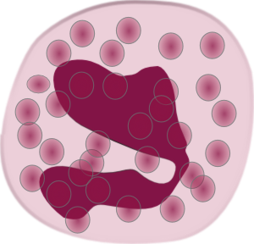



Assessing the epithelium: exhaled nitric oxide (FeNO) to assess the airway epithelium^{1,2}
Triggers
Allergen
Epithelial compartment (sputum)
Infections
50
Asthma
attack
rate
Eosinophils
25
Eotaxine-3
IL-4
IL-33
TARC
FeNO (ppb)
IL-5
IL-13
TSLP
0
0.15
0.30
Blood eosinophils (x10⁹/L)
Causal mechanism for ↑ biomarkerª
Correlation^{b}
IL-5
Systemic compartment (blood)
Figure adapted from Couillard S, et al. Chest. 2021;160(6):2019–29.
ªIL-13 and IL-5 increase biomarkers; ^{b}all cytokines and cells in black boxes correlate with biomarkers.
Abbreviations: FeNO, fractional exhaled nitric oxide; IL, interleukin; ppb, parts per billion; TARC, thymus and activation-regulated chemokine; TSLP, thymic stromal lymphopoietin.
References: 1. Couillard S, et al. Am J Respir Crit Care Med. 2021;204(6):731–34; 2. Couillard S, et al. Chest. 2021;160(6):2019–29.
6

Slide 7



Most patients may have multiple drivers of inflammation and overlapping phenotypes
Patients may display overlapping inflammatory pathways which may change over time owing to different circumstances, such as changes in medications, treatment adherence, exacerbations or exposure to allergens^{1–4}
Overlap of baseline positivity of three clinically used biomarkers from the International Severe Asthma Registry (N=1,175)⁵
The UK Severe Asthma Registry assessed patients (N=2,225) attending 15 specialist severe asthma centres.⁶ In this cohort:
Blood eosinophils positive
Median blood eosinophils was 0.33 cells x10⁹/L
Triple biomarker negative: 12%
8%
Median FeNO was 39 ppb
14%
8%
27%
7%
10%
14%
Median IgE level of 181 IU/mL
FeNO positive
IgE positive
Figure adapted from Denton E, et al. 2021.
Figure adapted from Denton E, et al. J Allergy Clin Immunol Pract. 2021;9(7):2680–88.
Abbreviations: FeNO, fractional exhaled nitric oxide; IgE, immunoglobulin E; IU, international unit; ppb, parts per billion.
References: 1. Busse WW. Allergol Int. 2019;68(2):158–66; 2. Tran TN, et al. Ann Allergy Asthma Immunol. 2016;116(1):37–42; 3. Price D, Canonica GW. World Allergy Organ J. 2020;13(8):100380; 4. Kupczyk M, et al. Allergy. 2014;69(9):1198–204; 5. Denton E, et al. J Allergy Clin Immunol Pract. 2021;9(7):2680–88; 6. Jackson DJ, et al. Thorax. 2021;76(3):220–7.

Slide 8

Multiple inflammatory pathways can be activated in upper and lower epithelial–driven diseases^{1–12}
DC
Neutrophil
DC
ILC1
CRSwNP^{2,3,6,7,13}
IgE
TSLP/
IL-25/
IL-33
EOS
Allergic rhinitis^{6,9}
Triggers
Severe asthma⁵
FeNO
Mast cells
COPD^{1,8}
TSLP
Macrophage
TSLP/
IL-33ª
Neutrophil
DC
Figure adapted from Caminati M, et al. Allergy. 2024;79:1134–45, with additional information from Porsbjerg CM, et al. Eur Respir J. 2020;56(5):2000260, Fokkens WJ, et al. Rhinology 2020;58(Suppl. S29):1–464, Arora A, Singh A. Int Rev Immunol. 2024;43(1):41-61, Calderon AA, et al. Eur Respir Rev. 2023;32:220144, Galli SJ, Tsai M. Nat Med. 2012;18(5):693-704 and Duong-Quy S. J Asthma Allergy. 2019;12:331-341. ªCascade has been simplified. Abbreviations: COPD, chronic obstructive pulmonary disease; CRSwNP, chronic rhinosinusitis with nasal polyps; DC, dendritic cell; EOS, eosinophil; FeNO, fractional exhaled nitric oxide; IgE, immunoglobulin E; IL, interleukin; ILC1; Type 1 innate lymphoid cell; TSLP, thymic stromal lymphopoietin. References: 1. Calderon AA, et al. Eur Respir Rev. 2023;32:220144; 2. Fokkens WJ, et al. Rhinol. 2020;58(Suppl.S29):1–464; 3. Staudacher AG, et al. Ann Allergy Asthma Immunol. 2020;124:318–25; 4. Victor AR, et al. J Immunol. 2017;199:2333–42; 5. Caminati M, et al. Allergy. 2024;79:1134–45; 6. Yii AC, et al. Allergy. 2018;73:1964–78; 7. Fokkens W, Reitsma S. Otolaryngol. Clin North Am. 2023;56:1–10; 8. Brightling C and Greening N. Eur Respir J. 2019;54:1900651; 9. Bousquet J et al. Nat Rev Dis Prim. 2020;6:95; 10. Global Initiative for Asthma. Global Strategy for Asthma Management and Prevention. May 2024. Available at: https://ginasthma.org/wp-content/uploads/2024/05/GINA-2024-Strategy-Report-24_05_22_WMS.pdf (Accessed 8 July 2024); 11. MacNee W. Proc Am Thorac Soc. 2005;2(4):258-66; 12. Heijink IH, et al. Clin Exp Allergy. 2014;44(5):620–630; 13. Heffler E, et al. Expert Rev Clin Immunol. 2018;14(9):731-737.
8

Slide 9
Epithelial IL-33, IL-25 and TSLP drive commonly overlapping respiratory diseases
The pathological mechanism driving epithelial diseases can vary, with multiple cells and mediators implicated:
IL-33
TSLP
IL-25
COPD
Increased in patients with COPD compared with healthy controls^{1,2} Correlates with disease severity and smoking-pack years^{1,3,4} |  | Higher levels have been shown in people with COPD^{5,6} Remains detectable in non-exacerbating patients with COPD^{5,7} |  | Increased in people with COPD and high levels of TSLP, compared with people with COPD and low TSLP levels⁶
Increased in patients with CRS compared with healthy controls⁸ Levels are higher in people with and without nasal polyps⁸ |  | Expression of TSLP mRNA in people with CRSwNP is increased versus people with CRSsNP, but in both diseases' expression is higher than in healthy controls⁹ |  | Can be elevated in people with CRSwNP compared with healthy control but not in those with CRSsNP¹⁰
Elevated in people with AR versus healthy controls^{11,12} Critical for the induction of local inflammation¹² Increased in patients with asthma, particularly those with rhinovirus infection or fungal (Aspergillus) sensitisation¹⁵ |  | Increased in the epithelium of people with AR versus healthy controls¹³ Higher expression in patients with asthma versus healthy controls¹⁵ |  | Positively correlates with AR severity and plays a crucial role in development of disease¹⁴ Expressed higher in the bronchial mucosa of patients with asthma versus controls¹⁶
CRS
AR
Asthma
Abbreviations: AR, allergic rhinitis; COPD, chronic obstructive pulmonary disease; CRS, chronic rhinosinusitis; CRSsNP, chronic rhinosinusitis without nasal polyps; CRSwNP, chronic rhinosinusitis with nasal polyps;
IL, interleukin; mRNA, messenger ribonucleic acid; TSLP, thymic stromal lymphopoietin.
References: 1. Joo H, et al. BMC Pulm Med. 2021;21(1):86; 2. Zhou Y, et al. J Transl Med. 2023;21(1):902; 3. Byers DE, et al. J Clin Invest. 2013;123(9):3967–82; 4. Kearley J, et al. Immunity. 2015;42(3):566–79; 5 Ying S, et al.
J Immunol. 2008;181(4):2790–98; 6. Wu L, et al. Int J Clin Exp Med. 2019;12(5):4942–48;; 7. Anzalone G, et al. Exp Mol Med. 2018;50(10):1–12; 8. Kim D-K, et al. Thorax. 2017;72(7):635–45; 9. Nagarkar DR, et al. J Allergy Clin Immunol. 2013;132(3):593–600.e12; 10. Kato A. Allergol Int. 2015;64(2):121–30; 11. Haenuki Y, et al. J Allergy Clin Immunol. 2012;130(1):184–94.e11; 12. Rogala B, Glück J. Curr Allergy Asthma Rep. 2013;13(2):196-202; 13. Kamekura R, et al. Inflamm Regen. 2008;28(3):160–65; 14. Liu Y, et al. J Immunol Res. 2018;2018:6519465; 15. Lambrecht BN, et al. Immunity. 2019;50(4):975-991; 16. Yao X, et al. Respirology. 2016;21(4):638-47.

